Slide 1
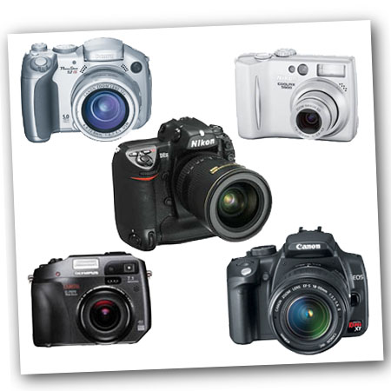
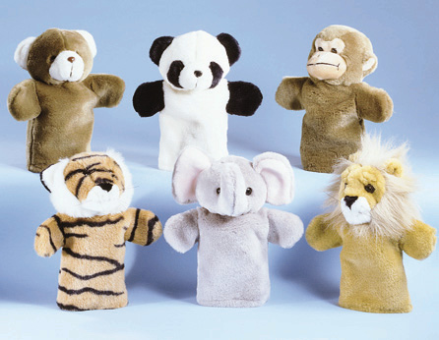
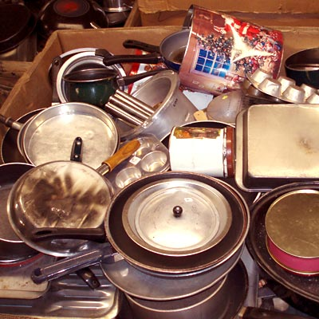
So, What Should or Can Be
Cataloged?
WHATEVER YOU
WANT!

Slide 2
MARC: Basic Tags
& Subfields
TAG | IND | TEXT and SUBFIELDS
082 | 0 4 | Call No.
245 | 0 0 | Title h[gmd] : b remainder of title.
260 |  | Place : b Publisher/Manufacturer , c date.
300 |  | No. & name of item : b further description ; c size.
5xx |  | Public notes (500) or summary (520) or (521) Target audience
650 | _0 | Subject heading.
690 |  | Purchase information
gmd = general material designation (eg. Game/Kit/ Equipment, etc.)
246 = varying form of title
250 = edition
538 = system details note
690 = subj: local (tag for P.O. Serial No. Barcode)
Notes:
gmd = general material designation (game/kit/realia/equip.)

Slide 3
Sample MARC Record
082 04[Call no.]
245 00 Cake pan h [realia] : b heart-shaped.
260 Savannah, GA : b Fun Cake Pan Co.,
c 2009.
300 4 pans : b non-stick, aluminum ; c 4 ½
in., 6 ½ in., 8 ½ in., 10 ½ in. x 2 in. deep
650 0 Cake pans.
650 0 Baking pans.
650 0 Baking.
690 Purchased at Wal-Mart 3/1/09; 8.98/set.

Slide 4
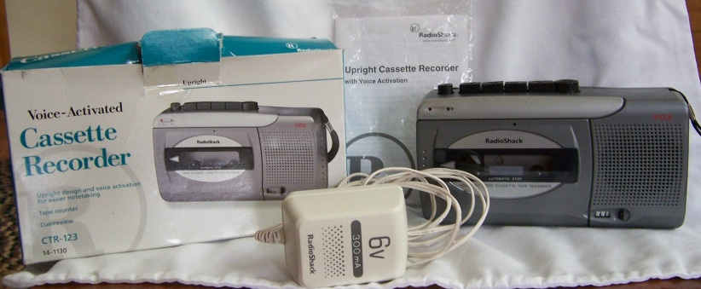
Audio-Visual Example – MARC
082 04 AV 1
245 00 Cassette recorder h [realia] : b voice-activated, CTR-123.
260 Fort Worth, TX : b Radio Shack, c 2001.
300 1 recorder (in box) ; c 4 x 7 in. + e 1 owner’s manual (19 p.) & 1
power adaptor.
500 This voice-activated cassette recorder/player features a tape counter
and cue/review feature. Can be used with 4 “AA” batteries (not
included).
500 Serial no. 2146-111470 02A03.
650 0 Cassette tape recorders.
650 0 Audio-visual equipment.
690 Purchased 3/27/2001 at Radio Shack, $29.00

Slide 5
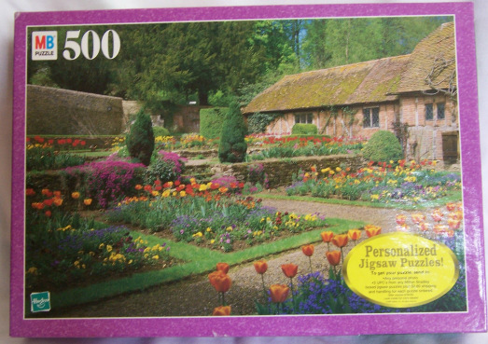
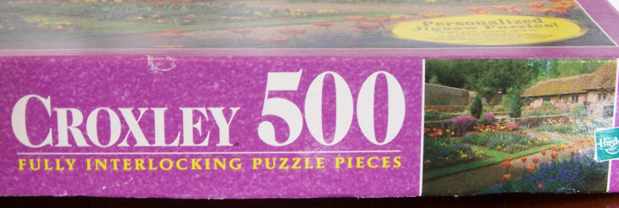
Puzzle Example -- MARC
082 04 PUZ 13
245 00 Jigsaw puzzle h [game] : b [English country garden and
cottage].
260 [S.l.] : b Hasbro, Inc., $c 1999.
300 1 jigsaw puzzle (500 pieces) : b col. ; c 8 in. x 12 in. (box)
500 This 500-piece cardboard jigsaw puzzle shows a colorful English
country garden and cottage.
500 “Croxley 500” – container.
500 Title by cataloger.
650 0 Jigsaw puzzles.
650 0 Puzzles.
690 Purchased 10/4/2002 at a fundraiser, $1.00.

Slide 6
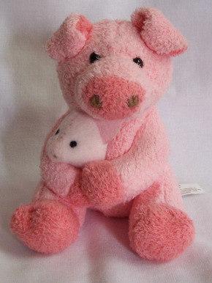
Stuffed Toy Example -- MARC
082 04 SA 5
245 00 Pig holding baby pig h [toy].
260 Oakland, N.J. : $b Russ Berrie & Co. c [200-?]
300 1 stuffed animal : b pink ; c 4 in.
500 This 4-inch high pink pig has a smaller baby pig clasped in the arms.
Contains inner bag pellets & polyester fiber and black plastic
eyes. Surface is washable (information from tag).
500 Item no. 23210. Made in China.
650 0 Soft toys.
650 0 Stuffed animals (Toys).
650 1 Pigs.
690 Purchased 7/17/2005 at Toys-R-Us for $4.95.

Slide 7
Understanding MARC
http://www.loc.gov/marc/umb/
http://www.loc.gov/marc/umb/um01to06.html#part3

Slide 8
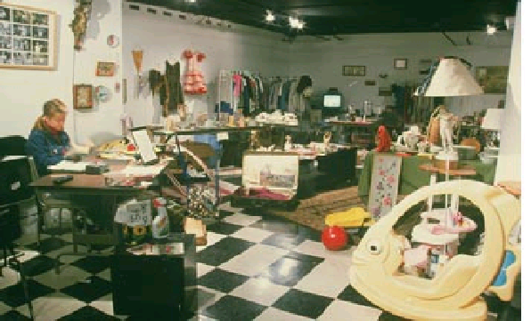
Let the Cataloging Begin

